Slide 1
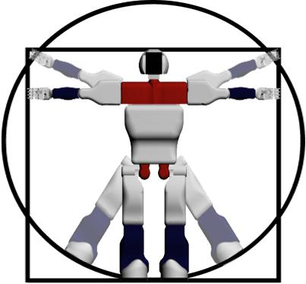
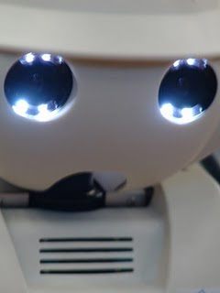
HuMANOID Postural planning
Miguel González – Fierro
Director: Carlos Balaguer

Slide 2
Thesis topics
Kinematics
Dynamics
Control
Stability
Artificial vision
Planning under constraints
Optimization
Simulation
(Learning)
OFFLINE

Slide 3
Motivation
M. Arbulu: Gait
D. Kaynov: Stabilizer
P. Pierro: ¿qué tramas?
New direction: Postural planning
Generalization of movements
Walking, dancing, sitting, jumping…
Creation of framework to define any kind of movement.

Slide 4
Expected results
Aportations
New definition of postures
This postures define any movement
New approach in dynamics, kinematics, stability…
Final demo:
Robot starts sitted, stands up and leave the room

Slide 5
THESIS ALGORITHM
1. Task planning
High level goal (GO and LEAVE the room starting from SITTED)
2.Environment analysis
Modeling of scenario & obstacles
(2D/3D environment map and identification of free space)
3. Path & activity planning (secure, collision-free & stable): generation of N points
- Path planning grueso
Static posture primitives generator
- Dynamic posture generator
- Path planning fino (N)

Slide 6
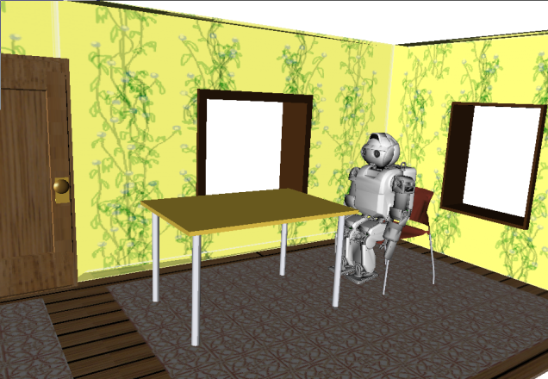
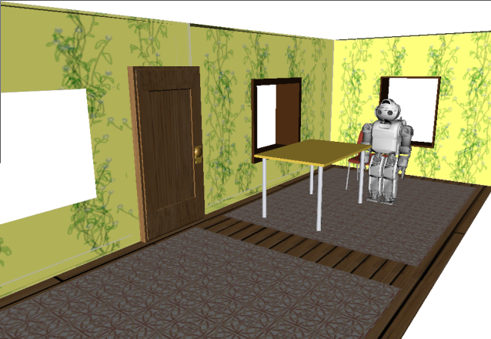
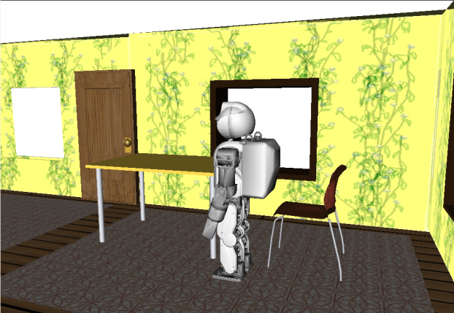
1. Task planning
High level goal (GO and LEAVE the room starting from SITTED)

Slide 7
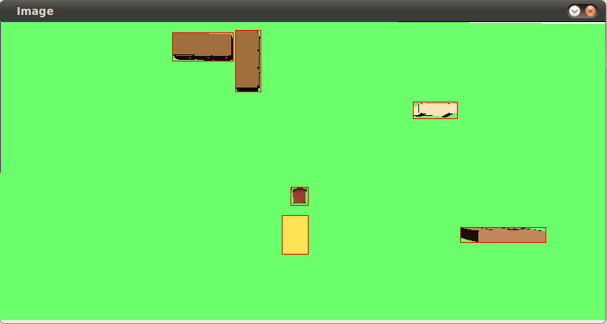
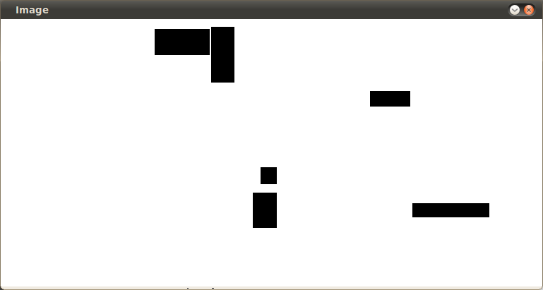
2.Environment analysis
Modeling of scenario & obstacles
(2D/3D environment map and identification of free space)
2D
3D
Model objects as boxes
Only the height is needed

Slide 8
3. Path & activity planning (secure, collision-free & stable): generation of N points
Path planning grueso = COG path planning
Path planning of COG
3D fast marching
PFC en marcha

Slide 9
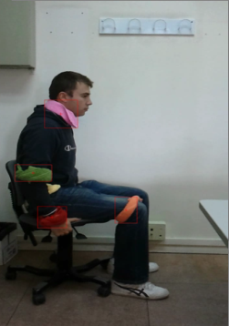
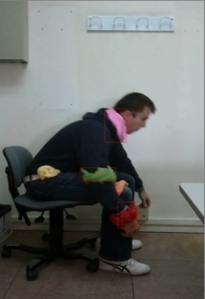
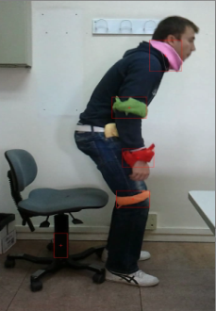
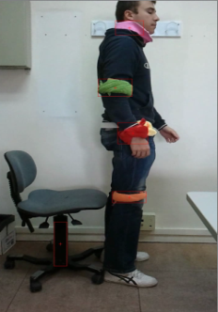
3. Path & activity planning (secure, collision-free & stable): generation of N points
Static posture primitive generation
Static posture (state)
Static Posture primitives (ptos iniciales y finales):
Sentado, De pie, Agachado, Inclinado ???, Tumbado (boca abajo), Tumbado (boca arriba)
b) Obtaining static postures (visión con tags, kinect, predefinidos…)
Activity planning:
Activity = 2 static primitives + 1 dynamic primitive

Slide 10
Dynamic posture primitive generation
3. Path & activity planning (secure, collision-free & stable): generation of N points
Interpolation between postures (action):
Dynamic Posture primitives
Andando, Girando, Corriendo, Saltando, Sentándose, Levantándose, Tumbándose boca arriba, Tumbándose boca abajo…
b) Obtaining dynamic postures (models, control, motion imitation)
Seguimiento de trayectorias humanas
Optimización COG dentro de poligono
Otras optimizaciónes ???

Slide 11
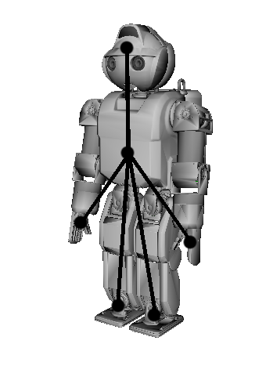
3. Path & activity planning (secure, collision-free & stable): generation of N points
Path planning fino = Postural path planning
PATH PLANNING FINO = Interpolación entre posturas dinamicas
Calculo de transicion suave (criterio: min torque, min Energia,…) = reajuste
Collision free (path planning de todo el cuerpo ???)
Main points

Slide 12
Conseguido hasta ahora
Cinemática de HOAP, pendulos (simple, doble, triple)
Dinámica HOAP (sin fuerzas de contacto) y triple péndulo
Sistema de tracking con tags
Openrave

Slide 13
Trabajando ahora
Control del triple péndulo
Paper sobre el baile de Valladolid
Paper sobre camera stabilization

